Slide 1
NEEDFINDING
Jocelyn Hickcox, Daniel Melendez, Ashley Mills
Notes:
introduction

Slide 2
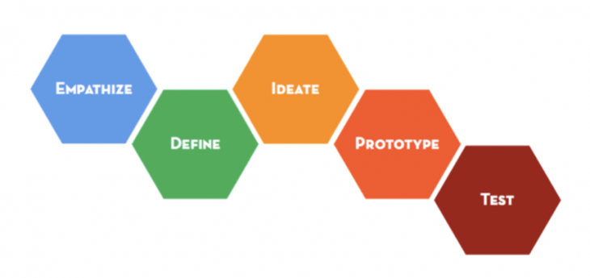

Slide 3
Learning about the audience we are designing for

Slide 4
METHODOLOGY
MASTERY
AUTONOMY
EXPLORING IDEAS
FLOW
PURPOSE
FOCUS
HEARTH
FAMILY
STRUGGLE
ADHD
WORKING PARENTS
SOCIAL MEDIA

Slide 5
METHODOLOGY
MASTERY
AUTONOMY
EXPLORING IDEAS
FLOW
PURPOSE
FOCUS
HEARTH
FAMILY
STRUGGLE
ADHD
WORKING PARENTS
SOCIAL MEDIA

Slide 6
METHODOLOGY
NARROWING THE PROBLEM
Disabilities that affect someone’s ability to focus
Chose to interview extreme users:
ADHD
OCD
Autism
Notes:
interviewed extreme users who have varied relationship w/ focus and attention

Slide 7
METHODOLOGY
INTERVIEWING EXTREME USERS
“What would surprise us about the way you handle focus?”
“What frustrates you the most about that?”
“What are some challenges you face on a day-to-day basis that you think most people don’t?”
“Tell us about a strategy you use to stay focused or perform a task.”
“What are you most proud of about what you’ve learned?”

Slide 9
We met Lauren, a learning specialist for ADHD at the Office of Accessible Education.
We were were amazed by how strongly she felt about the importance of guidance, encouragement, and a support system for those with ADHD.

Slide 10
EMPATHY MAP: ADHD
SAY
“I’ll never be able to keep track of time”
“My third grade teacher was the key to my success”
THINK
This is just who I am- there’s nothing I can do about it
I just needed someone to believe in me and support me

Slide 11
EMPATHY MAP: ADHD
DO
Drawn to the most immediately interesting and satisfying thing
Behave too impulsively for most environments
FEEL
I do what’s exciting- and I’m just being myself!
I am inadequate and can’t do anything right

Slide 12
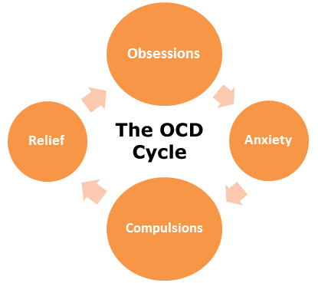

Slide 13
We met Kristen, an elementary school teacher who struggles to manage her focus due to OCD.
We found it interesting that hyperfocus worked against her ability focus, rather than amplify it.
Her OCD created a forgetfulness she was very insecure and anxious about.

Slide 14
EMPATHY MAP: OCD
SAY
“I’m constantly paranoid I’ll forget something”
“I feel like an impostor"
THINK
I can’t trust myself to remember everything
Need to put on an act to look normal

Slide 15
EMPATHY MAP: OCD
DO
Intrusive reminders for everything
Once she starts something, she has to finish it
Socializes a lot
FEEL
Scared of messing up and being a let-down
Anxious
Want to get out of my own head

Slide 17
We met Spencer, a Stanford student heavily involved in Autism Speaks and whose 17 year old brother is autistic.
We found it interesting that he preferred speaking to his brother with encouragement rather than with command to help him create his own language.

Slide 18
EMPATHY MAP: AUTISM
SAY
Dismisses conversation with “Yes yes”
“Tyler what time is it?” “People time”
THINK
I know what I like. Conversation isn’t important to me, but I know that I have to say something
We need to mediate Tyler’s interactions and direct his focus

Slide 19
EMPATHY MAP: AUTISM
DO
Watches movies and listens to soundtracks over and over again
Distracted by tech around him to a severe degree
He can learn but not in all environments
FEEL
I’m comfortable with what’s familiar
I’m annoyed I have pay attention to things I don’t care about nor understand
I want my parents to approve of me and be happy

Slide 20
INSIGHTS

Slide 21
INSIGHTS
This assignment helped us understand how hard it can be for people who struggle with focus on an extreme level

Slide 22
INSIGHTS
This assignment helped us understand how hard it can be for people who struggle with focus on an extreme level
It was eye-opening to learn about the frustration, shame, and desire to do better but not knowing how

Slide 23
INSIGHTS
This assignment helped us understand how hard it can be for people who struggle with focus on an extreme level
It was eye-opening to learn about the frustration, shame, and desire to do better but not knowing how
It would be beneficial to create a system of support, reassurance, and self-reliance to build motivation and improve focus

Slide 24
SUMMARY
Moving forward, how might we…
lessen feelings of inadequacy and self-doubt surrounding focus?
provide resources and strategies that help improve focus over time?
create a safe and supportive environment that embraces creativity and scattered thoughts?

Slide 25
Next steps: defining a POV based on user needs and insights

